Slide 1
Social Influence Part II

Slide 2
Topics in this Unit
Schema Theory
Reconstructive Memory
Bystanderism
Prosocial Behaviour
Promoting Prosocial Behaviour

Slide 3
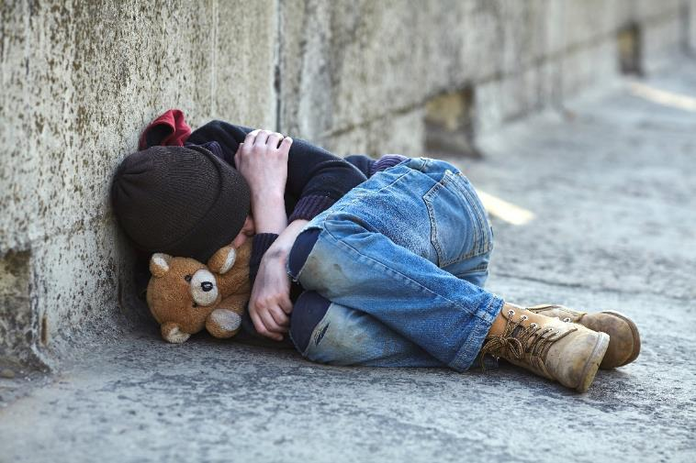
Bystanderism
Topic 3.9
Why don’t people help those in need?

Slide 4
Topic’s Key Questions
By the end of this topic you should be able answer these questions:
What is bystanderism?
What factors influence bystanderism?
What are the applications and/or limitations in explanations of bystanderism?

Slide 5
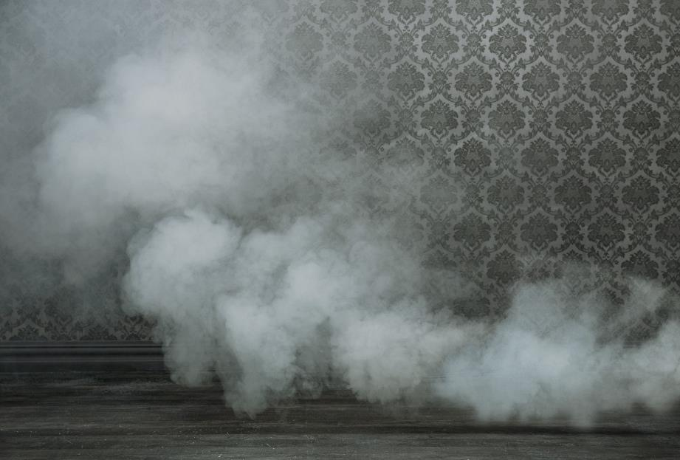
Topic 3.9 Bystanderism
The Smoky Room Study
Chapter 3: Social Influence

Slide 6
Review
In the last topic we studied how memory might not be reliable and how this has had big implications in the field of eye-witness testimony.
Following on from the theme of witnessing a crime, we’re now looking at why some people might witness an emergency (crime or otherwise) and not help. This is called “bystanderism” and we’re going to learn why it happens.

Slide 7
Kahoot
Play this game of Kahoot that recaps the topics and studies that we’ve covered so far (3.7-3.8 Schema Theory and Reconstructive Memory).

Slide 8
Today’s Key Questions
By the end of this lesson you should be able answer these questions:
What were the methods and results of Darley and Latane’s (1968) smoky room study?
How does the smoky room study demonstrate the effects of informational social influence?
How could the results of this study be used to show the effects of normative social influence?

Slide 9
Have you ever…
…witnessed bystanderism?
Share with a partner any experiences you can remember and then we’ll share as a class.

Slide 10
Watch…
This video (link) about the Kitty Genovese story and the following studies (6 minutes).
The video explains the famous story of Genovese that sparked research into bystanderism.
Notes:
There’s a very graphic description in Slater’s “Opening Skinner’s Box” that is good to read aloud if you have that book, too.

Slide 11
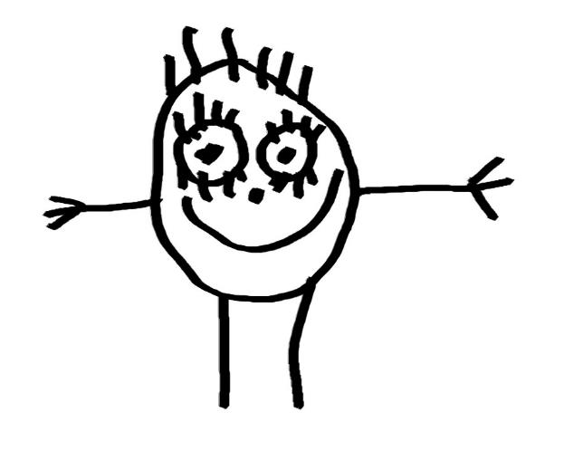
Painting Picasso’s
One person has the key terms
The other has the smoky room study.
You have to turn this information into a visual representation (image) and then teach it to your partner using on their images.
This is followed by a quiz.
The information you need is in the textbook and instructions are in the workbook.

Slide 12
Quiz!
Let’s play this Quizizz (link) to see how well you learned (and taught) the material.
You should work together to answer the guiding question after you finish the quiz and get that answer checked, too.

Slide 13
How does the smoky room study demonstrate the effects of informational social influence??
There’s information in the textbook to help you if you need it.
Critical Thinking Extension:
Could the results be explained by normative social influence, too?

Slide 14
REFLECT: Today’s Key Questions
Can you answer these questions?
What were the methods and results of Darley and Latane’s (1968) smoky room study?
How does the smoky room study demonstrate the effects of informational social influence?
How could the results of this study be used to show the effects of normative social influence?
NEXT LESSON: Diffusion of Responsibility

Slide 15
Reflect: 5 Tips for Success
Five top tips for success: which of these could you be doing better?
(Link to post about the five tips).

Slide 16
Bystanderism
Topic 3.9
Why don’t people help those in need?

Slide 17
Charades
Write a key term, study or detail on a post-it
Reconstructive memory
Bystanderism
Schema theory
Team game
We play until all entries are finished.
Be careful: you might have to act out your own entry.
Notes:
This is a fun and active recapping game.

Slide 18
Review
Last lesson you were introduced to the concept of bystanderism and informational social influence
We saw how people might look to others for guidance on how to act in ambiguous situations – this could explain bystanderism
We’re now looking at a second possible explanation for bystanderism

Slide 19
Today’s Key Questions
By the end of this lesson you should be able answer these questions:
What is “diffusion of responsibility?”
How might diffusion of responsibility influence bystanderism?
Could the results of studies on diffusion of responsibility be questioned on the grounds of generalizability?

Slide 20
Watch…
This video about the Bystander Effect (link) (7 mins), hosted by Zimbardo and including some footage from UK documentaries.

Slide 21
Diffusion of Responsibility
Responsibility – a feeling of obligation to do something
Diffusion – to dilute or spread something out
Diffusion of responsibility – feeling less obligation to do something because there are more people to share the responsibility
Bystander Effect – the more people around to help, the less likely they are to help (possibly due to diffusion of responsibility)

Slide 22
Diffusion of Responsibility: Studies
Population density: how many people live per square mi/km
Tokyo, LA and Hong Kong have high population density
Siberia, Alaska and Mongolian desert have low population density
Levine et al: studied 36 cities in the USA to measure correlations between population density and helping behaviour
Conducted in the field
Research assistants pretended to drop a pen, a postcard, or needed help crossing the street
Found that helping others began to decline in cities over 300,000 people

Slide 23
Diffusion of Responsibility: Studies Cont…
Steblay conducted a meta-analysis on 65 studies that compared rates of helping in rural and urban areas
Found evidence to support the hypothesis that people living in rural areas were more helpful than those in cities
This research supports the hypothesis that diffusion of responsibility can explain examples of bystanderism

Slide 24
Watch…
Watch this test done for a news show where they pretend to abduct a girl and see if anyone would help (link) (6 mins).
Is this because of diffusion of responsibility?

Slide 25
Quiz!
Do this Quizizz (link) as a check-in for knowledge of terms and studies introduced in this lesson.
Fast Finishers: Students take down notes about two studies that show diffusion of responsibility from the lesson in the textbook (space in workbook).
Add to the “space for notes” table in the workbook, too.

Slide 26
How might diffusion of responsibility influence bystanderism?
Need help? There’s an explanation in the textbook.
Extension: If you’re interested, You can watch this video (link) (6 mins) about what the reporters originally got wrong in the Kitty Genovese story.

Slide 27
REFLECT: Today’s Key Questions
Can you answer these questions?
What is “diffusion of responsibility?”
How might diffusion of responsibility influence bystanderism?
Could the results of studies on diffusion of responsibility be questioned on the grounds of generalizability?
NEXT TOPIC:
Prosocial Behaviour

Slide 28
Topic’s Key Questions
Now we’re at the end of this topic, you should be able answer these questions:
What is bystanderism?
What factors influence bystanderism?
What are the applications and/or limitations in explanations of bystanderism?

Slide 29
Homework
Write down two things to do before the next class that will help you keep up with the work.

Slide 30
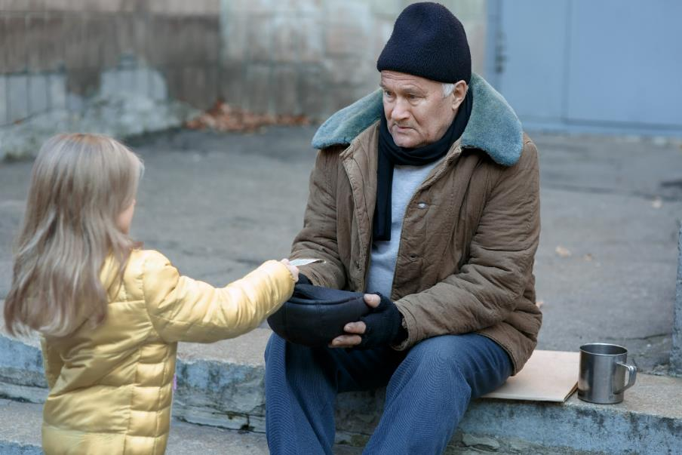
End of Topic 3.8
Next Topic = Prosocial Behaviour

